Slide 1
INVASIVE SPECIES JEOPARDY

Slide 2
What are they?
How they move
What’s the issue?
What can be done?
Who am I?
$ 200
$ 200
$ 200
$ 200
$ 200
$ 400
$ 400
$ 400
$ 400
$ 400
$ 600
$ 600
$ 600
$ 600
$ 600
$ 800
$ 800
$ 800
$ 800
$ 800
$1000
$1000
$1000
$1000
$1000

Slide 3
Invasive species are:
A non-native species that causes negative impacts
A species from somewhere else
Any species that you find in your yard that you don’t like
Answer

Slide 4
Invasive species are found:
In all habitats: wetlands, forests, lakes, etc.
Only in degraded ecosystems
Only in the water
Answer

Slide 5
Invasive species are non-native, which means:
Species introduced by human action
Species that exist in a habitat where they were not previously found
All of the above
Answer

Slide 6
Name 3 characteristics that invasive species can have that give them a competitive advantage over native species.
Answer

Slide 7
Provide 3 examples of invasive species and one of their impacts on the environment or humans
Answer

Slide 8
True or False
Humans are responsible for introducing the majority of invasive species
Answer

Slide 9
True or False
Invasive species arrive to new territory by transportation vehicles such as planes, boats, cars and ATV’s.
Answer

Slide 10
What was the main form of introduction of aquatic invasive species?
Boats
Ballast water
Dumping bait
Releasing pets
Answer

Slide 11
What are three ways invasive species are brought to Ontario or three ways they spread once they’re in Ontario?
Answer

Slide 12
Answer

Slide 13
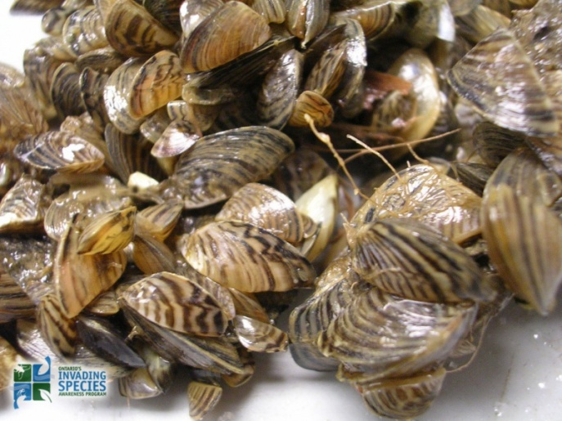
This invasive species are:
Zebra Mussels
Clams
Shells
Answer

Slide 14
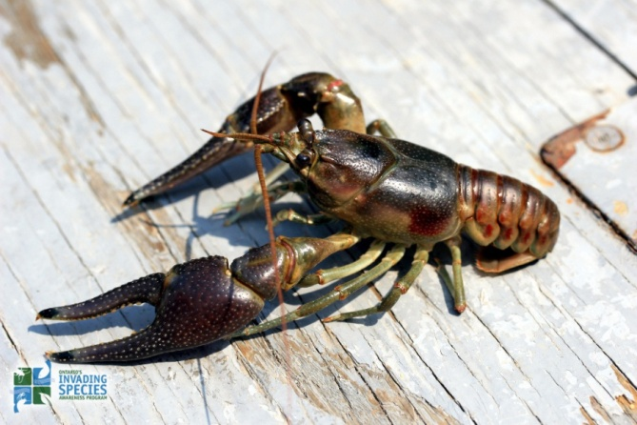
This invasive species is the:
Crab
Lobster
C) Rusty Crayfish
Answer

Slide 15
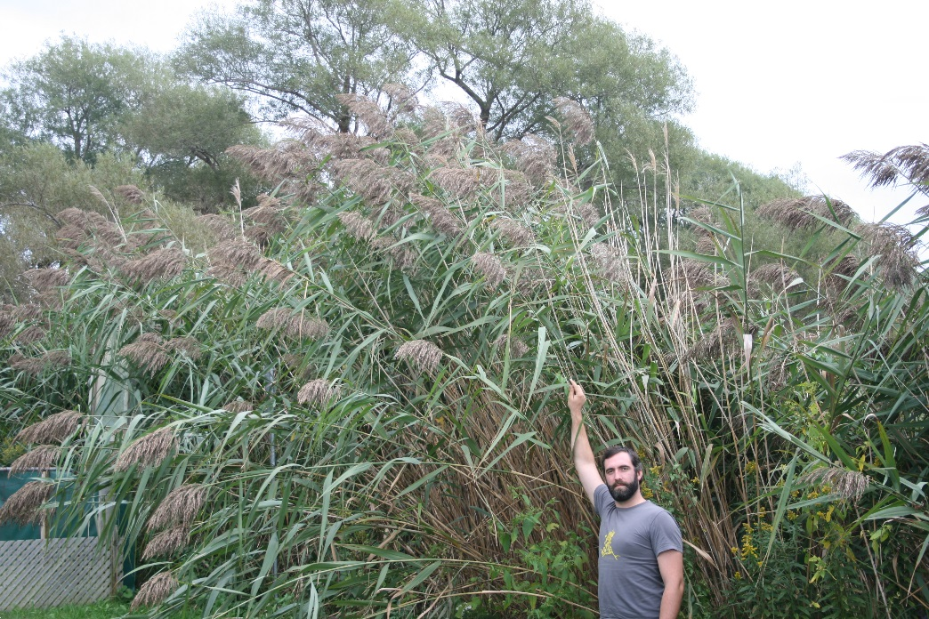
This invasive species is:
Hydrilla
Purple Loosestrife
Phragmites
Answer

Slide 16
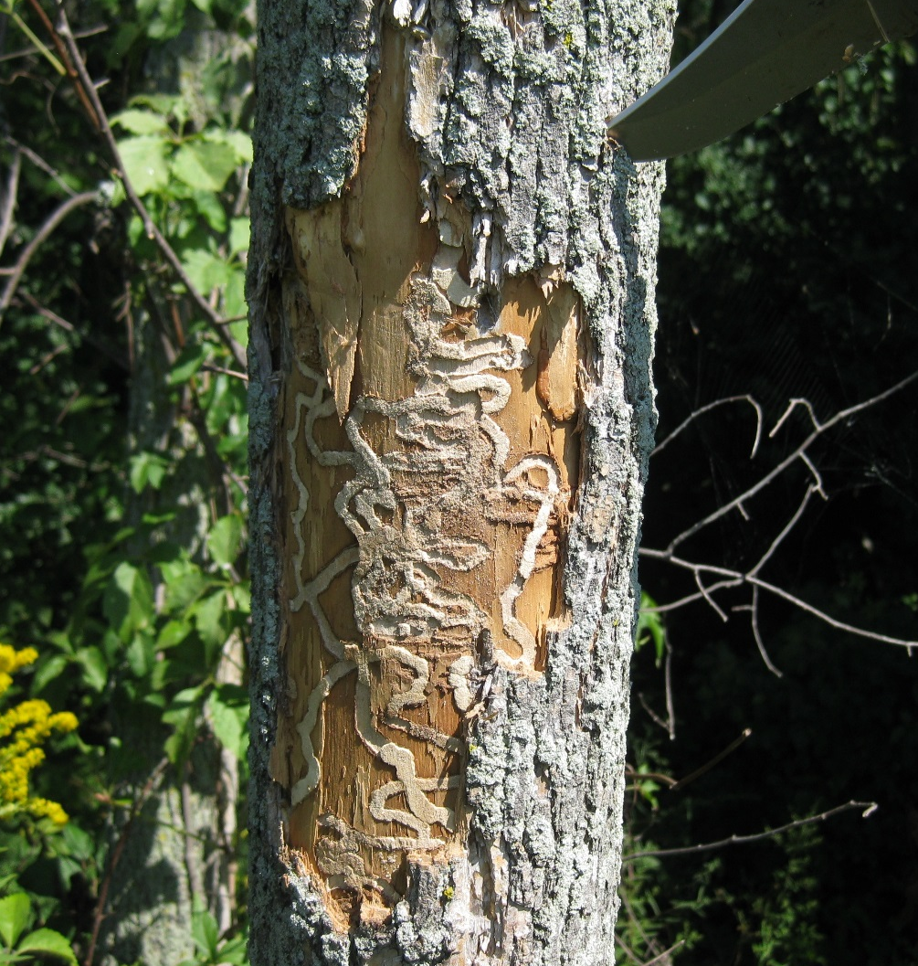
These marks are caused by the:
Mountain Pine Beetle
Termites
Emerald Ash Borer
Answer

Slide 17
Which species of Asian Carp is this?
Eyes in line with mouth
No barbels
Wider body shape
Individuals have been found in the Great Lakes
Answer

Slide 18
Invasive species are an issue for ecosystems because:
They are not originally from Ontario
They decrease ecosystem resilience and biodiversity
Answer

Slide 19
Invasive species cost the Canadian economy:
$30 Million/year
$500,000/year
$30 billion/year
Answer

Slide 20
Asian Carp impact our native species by:
Eating native fish
Eating large amounts of food, leaving nothing for our species
They make the water murky
Answer

Slide 21
What is an example of a social impact of invasive species?
Answer

Slide 22
How can you avoid accidently releasing or moving an invasive species?
Learn how to identify invasive species that threaten Ontario
Don’t go outside
Nothing
Answer

Slide 23
What is the method that the Chicago shipping canal is using to manage Asian Carp?
Telling them to go away
Fishing derby
Electrical Barriers
Answer

Slide 24
What should you do if you find a prohibited invasive species?
Report it to the Invasive Species Awareness Program
Take a picture of it
Don’t release it back into the wild
All of the above
Answer

Slide 25
Name three things you can do to limit the spread of invasive species
Answer

Slide 26
Name the two resources mentioned to report invasive species
Answer

Slide 27
Invasive species are:
A) A non-native species that causes negative impacts

Slide 28
Invasive species are found in:
A) In all habitats: wetlands, forests, lakes, etc.

Slide 29
Invasive species are non-native, which means:
C) All of the above

Slide 30
Few natural predators
Out compete native species for food and habitat
Adaptable
Able to thrive in disturbed environments
Reproduce quickly

Slide 31
Examples:
Asian carps: alter habitat by eating lots of aquatic vegetation, disturb food webs by competing with native species for resources,silver carp jumping affect recreation, reduced success of commercial and recreational fishing
Giant hogweed: can cause injuries due to phototoxic sap
Zebra mussels: filter water of algae and reduces food for other species, sharp shells can injure swimmers
Hydrilla: can reduce the flow of water in canals and ditches up to 85%

Slide 32
True
Humans are responsible for introducing the majority of invasive species

Slide 33
True
Invasive species arrive to new territory by transportation vehicles such as planes, boats, cars and ATV’s.

Slide 34
What was the main form of introduction of aquatic invasive species?
B) Ballast water
50% of aquatic invasive species in Ontario!

Slide 36
How they get here
Ballast water
International shipping
Aquarium Industry
Gardening industry
Unauthorized introductions
How they spread once they’re here
Movement of firewood
Dumping live bait
Boats
Outdoor gear
Pets
Pet release
Disposing of aquarium plants/garden clippings

Slide 37
These marks are caused by the:
B) Emerald Ash Borer

Slide 38
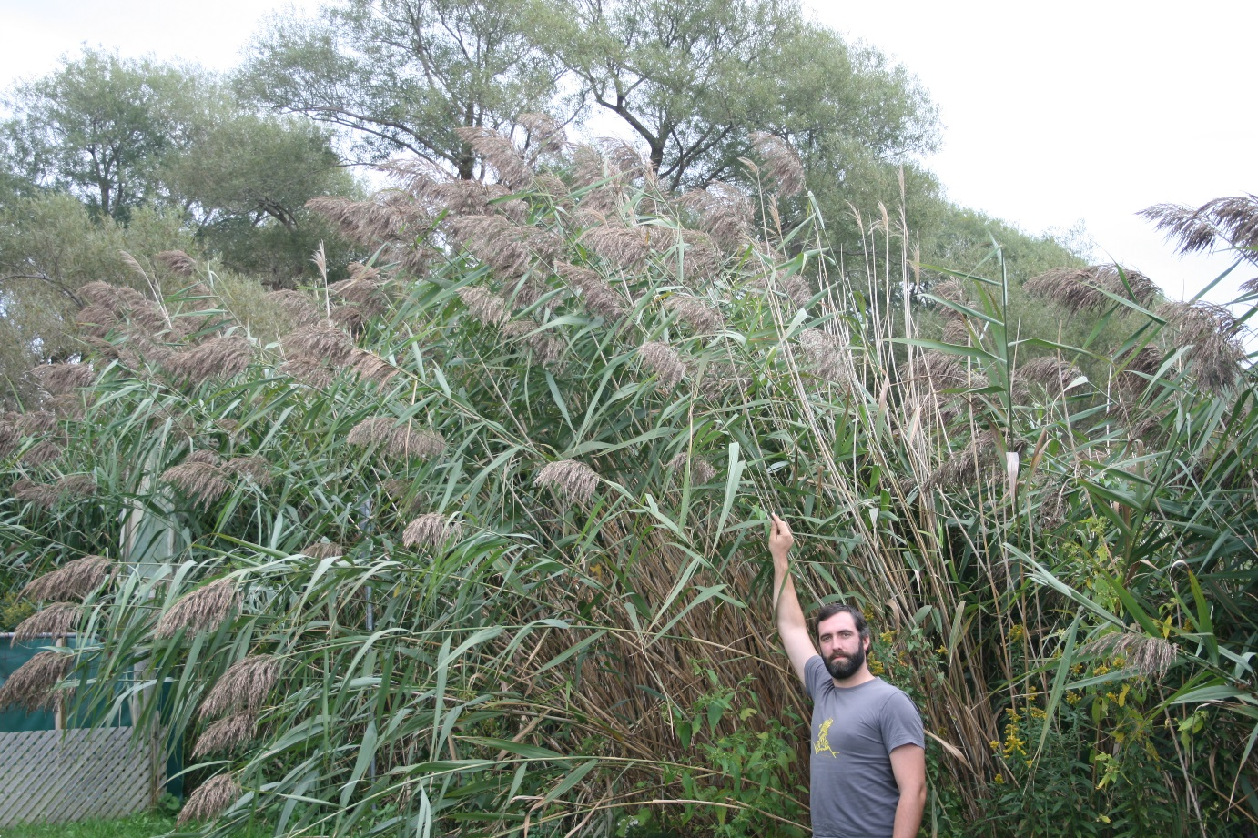
This invasive species is:
C) Phragmites

Slide 39
This invasive species is:
Zebra Mussels

Slide 40
This invasive species is the:
C) Rusty Crayfish

Slide 41
What species of Asian Carp is this?
Grass Carp

Slide 42
Invasive species are an issue because:
B) They decrease ecosystem resilience and biodiversity

Slide 43
Asian Carp impact our native species by:
B) Eating large amounts of food, leaving nothing for our species

Slide 44
Invasive species cost the Canadian economy:
C) $30 billion/year

Slide 45
Social impacts include;
-Impacts on agriculture
-Impacts on livelihoods
-Reduced recreation (boats, hiking)
-Health risks (disease/stagnant water)

Slide 46
What is the method that the Chicago shipping canal is using to manage Asian Carp?
C) Electrical Barriers

Slide 47
How can you avoid accidently releasing or moving an invasive species?
Learn how to identify invasive species that threaten Ontario

Slide 48
What should you do if you find a prohibited invasive species?
D) All of the above

Slide 49
What you can do to stop the spread of invasive species:
Learn to identify invasive species
Check your equipment and pets for invasive species
Don’t dump baitfish into water after fishing
Don’t dispose of pets, aquarium plants, or garden clippings in natural areas
Wash or dry your boat, tackle, downriggers, trailer and other outdoor equipment to remove invasive species
Don’t move firewood that could contain forest pests

Slide 50
EDDMapS
Invasive Species Hotline -
1-800-563-7711

