Slide 1
What are they?
How they
got here
Invasive Impacts
How can I help?
Who am I?
$ 200
$ 200
$ 200
$ 200
$ 200
$ 400
$ 400
$ 400
$ 400
$ 400
$ 600
$ 600
$ 600
$ 600
$ 600
$ 800
$ 800
$ 800
$ 800
$ 800

Slide 2
Invasive Species Jeopardy
Organize your class into 4 groups, make sure you listen to everyone’s opinion and reach a consensus as a team!

Slide 3
Invasive species are:
Plants and animals that migrate in the winter
Species not from Canada that invade and push out our native species
Answer

Slide 4
Invasive species are found:
In all habitats: wetlands, woodlands and waters
Only in the ocean
Playing hide and seek
Answer

Slide 5
Invasive species are:
Animals and plants that travel the world
Animals and plants that establish in an area that is not their natural home
Answer

Slide 6
Invasive species can be:
Any living species
Only fish
Only plants
All species are invasive
Answer

Slide 7
True Or False
Invasive species arrive to new territory by hitchhiking on goods or packages when travelling
Answer

Slide 8
True Or False
Invasive species arrive to new territory by
transportation vehicles such as airplanes, boats, cars and ATV’s.
Answer

Slide 9
True Or False
Invasive species arrive to new territory by
driving their car or taking the first plane to Ontario!
Answer

Slide 10
True Or False
Invasive species arrive to new territory by attaching to your shoes, clothing or even your dog after walking in the forest.
Answer

Slide 11
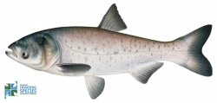
This invasive species is the:
A) Smallmouth bass
B)Bighead carp
C) Rainbow trout
Answer

Slide 12
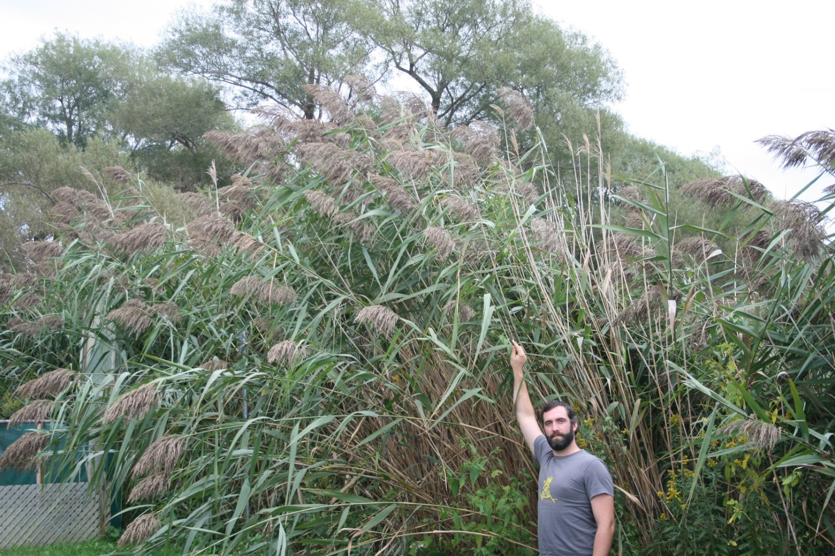
This invasive species is:
Purple loosestrife
Invasive phragmites
Common buckthorn
Answer

Slide 13
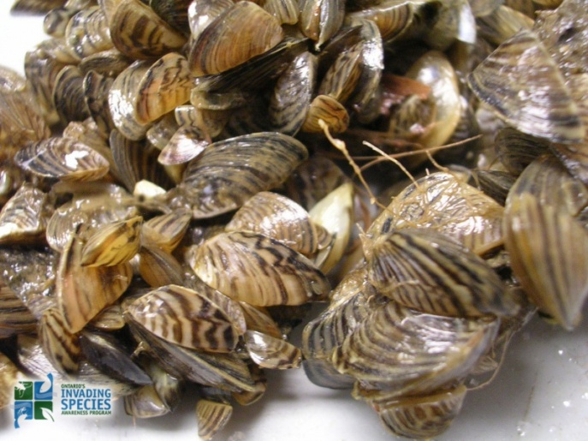
This invasive species is:
Zebra Mussels
Chinese mystery snail
Rusty crayfish
Answer

Slide 14
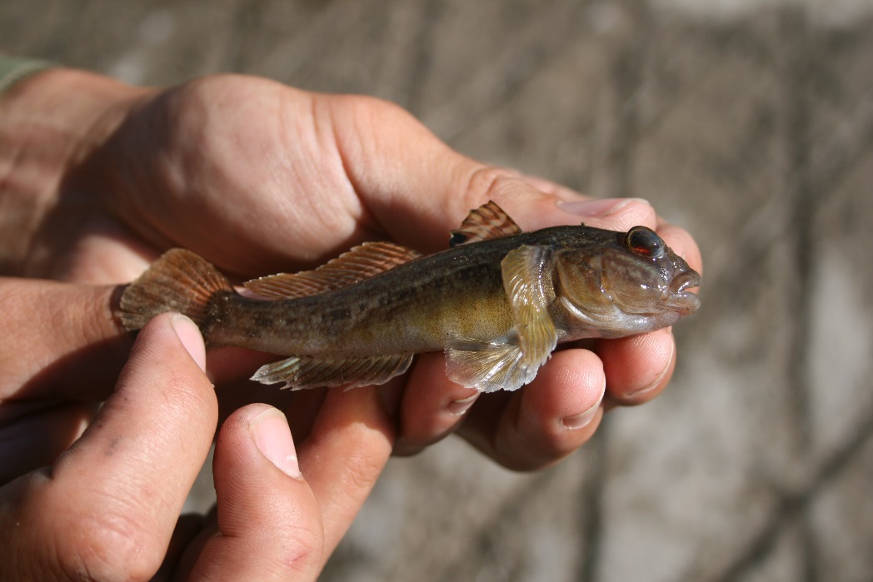
This invasive species is the:
Grass carp
Goldfish
Round goby
Answer

Slide 15
Invasive species are an issue because:
They are able to fit into any habitat
They out-compete our native species
They always leave a huge mess after a sports game
Answer

Slide 16
Invasive species are like bullies because:
They damage natural habitats, native species and the ecosystem
They play their music too loud
They don’t get along with others
Answer

Slide 17
Invasive species take away things that our native species need such as:
Food
Water
Shelter
All of the above
Answer

Slide 18
Invasive species have an advantage over native species because:
They can grow really fast & spread quickly
They can create a lot of eggs, offspring or seeds
They may harm or eat native species (are predatory)
All of the above
Answer

Slide 19
Invasive species are:
B) Species not from Canada that invade and push out our native species

Slide 20
Invasive species are found:
In all habitats: wetlands, woodlands and waters

Slide 21
Invasive species are:
B) Animals and plants that establish in an area that is not their natural home

Slide 22
Invasive species can be:
Any living species

Slide 23
True
Invasive species arrive to new territory by hitchhiking on goods or packages when travelling

Slide 24
True
Invasive species arrive to new territory by transportation vehicles such as airplanes, boats, cars and ATV’s.

Slide 25
False
Invasive species arrive to new territory by driving their car or taking the first plane to Ontario!

Slide 26
True
Invasive species arrive to new territory by attaching to your shoes, clothing or even your dog after walking in the forest.

Slide 27
This invasive species is the:
B)Bighead Carp

Slide 28
This invasive species is:
B) Invasive phragmites

Slide 29
This invasive species are:
Zebra Mussels

Slide 30
This invasive species is the:
C) Round goby

Slide 31
Invasive species are an issue because:
B) They out-compete our native species

Slide 32
Invasive species are like bullies because:
They damage natural habitats, native species and the ecosystem

Slide 33
Invasive species take away things that our native species need such as:
D) All of the above (food, water & shelter)

Slide 34
Invasive species have an advantage over native species because:
D) All of the above

Slide 35
What can you do to stop the spread of invasive species?
Learn how to identify invasive species that threaten Ontario
Get your firewood from very far away
Nothing
Answer

Slide 36
What can you do to stop the spread of invasive species?
Take home every type of plant or fish you see when outside
Release unwanted pets into the wild instead finding them a new home
Never collect plants or fish from the wild
Answer

Slide 37
What can you do to stop the spread of invasive species on the water?
Drive your boat REALLY fast to avoid picking up any plants or species that could be invasive
Wash or dry your boat, tackle, trailer and other boat equipment to kill harmful species
Make sure you wear your lifejacket
Answer

Slide 38
What can you do to stop the spread of invasive species?
Look Before you Leave- mud can carry seeds on bikes or ATV’s
Clean your muddy boots and check your pet’s fur
Don’t dump baitfish into water after fishing
All of the above
Answer

Slide 39
What can you do to stop the spread of invasive species?
Learn how to identify invasive species that threaten Ontario

Slide 40
What you can do to stop the spread of invasive species:
C) Never collect plants or fish from the wild

Slide 41
What can you do to stop the spread of invasive species on the water?
B) Wash or dry your boat, tackle, trailer and other boat equipment to kill harmful species

Slide 42
What can you do to stop the spread of invasive species?
D) All of the above

