Slide 1
What are they?
How they
got here
Invasive Impacts
How can I help?
Who am I?
$ 200
$ 200
$ 200
$ 200
$ 200
$ 400
$ 400
$ 400
$ 400
$ 400
$ 600
$ 600
$ 600
$ 600
$ 600
$ 800
$ 800
$ 800
$ 800
$ 800

Slide 2
Invasive Species Jeopardy
Organize your class into 4 groups, make sure you listen to everyone’s opinion and reach a consensus as a team!

Slide 3
Invasive species are:
Species that migrate in the winter
Species from another part of the world that cause a negative impact on our environment
Answer

Slide 4
Invasive species are found:
In all habitats: wetlands, woodlands and waters
Only in the ocean
Playing hide and seek
Answer

Slide 5
ISAP was created to address the increasing threat invasive species pose to Ontario. What does ISAP stand for?
Invasive Species Are Problems
Invading Species Activity Program
Invading Species Awareness Program
Invasive Species Awareness Plan
Answer

Slide 6
Invasive species can be:
Any living species
Only fish
Only plants
All species are invasive
Answer

Slide 7
True Or False
Invasive species arrive to new territory by hitchhiking on goods or packages when travelling
Answer

Slide 8
True Or False
Invasive species can be spread to new areas by transportation vehicles such as airplanes, boats, cars and ATV’s.
Answer

Slide 9
True Or False
Round gobies were mainly spread by escaping from anglers’ hooks when used for fishing
Answer

Slide 10
True Or False
Invasive species arrive to new territory by attaching to your shoes, clothing or even your dog after walking in the forest.
Answer

Slide 11
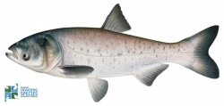
This invasive species is the:
Smallmouth bass
Bighead carp
Rainbow trout
Answer

Slide 12
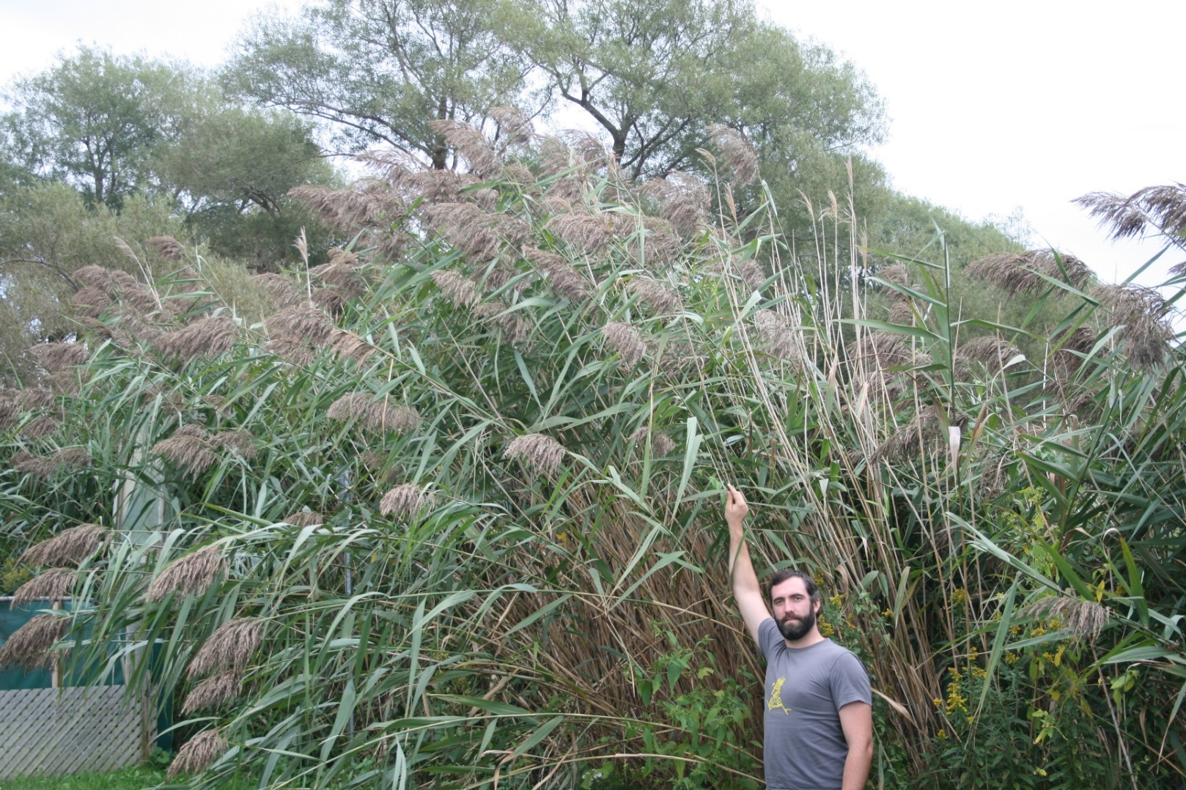
This invasive species is:
Purple loosestrife
Invasive phragmites
Common buckthorn
Answer

Slide 13
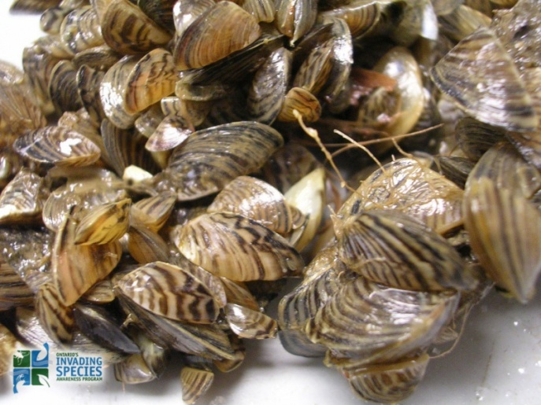
This invasive species is:
Zebra mussels
Chinese mystery snail
Rusty crayfish
Answer

Slide 14
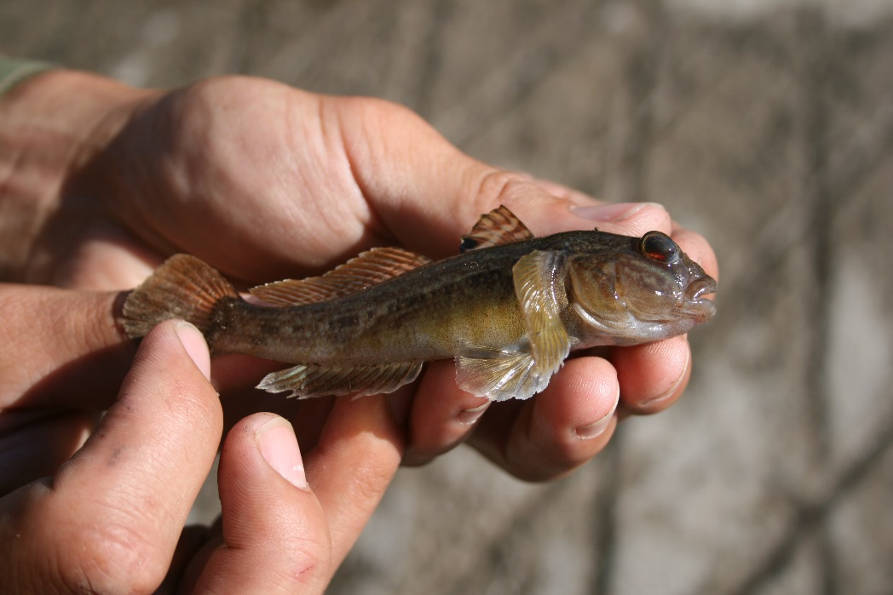
This invasive species is the:
Grass carp
Goldfish
Round goby
Answer

Slide 15
What makes a species so invasive?
They are highly adaptable
They have few natural predators
They out-compete native species for food and habitat
All of the above
Answer

Slide 16
The introduction of invasive species can:
Increase biodiversity in an ecosystem
Leave biodiversity undisturbed
Reduce biodiversity in an ecosystem
Invasive species and biodiversity aren’t related
Answer

Slide 17
What is an example of a social impact of invasive species?
A landowner has to pay to have dog-strangling vine removed from their property
Asian carp compete with native species for food
Giant hogweed poses a health risk to hikers because of its phototoxic sap
Invasive species don’t get invited to any parties
Answer

Slide 18
What is an example of an economic impact of invasive species?
Buckthorn has reduced the tree diversity at your favourite park and now less birds use the area
Someone released their goldfish into a pond and now they are competing with native fish for food
Phragmites has taken over your local wetland and the town must pay lots of money to control it
Answer

Slide 19
Invasive species are:
B) Species from another part of the world that cause a negative impact on our environment

Slide 20
Invasive species are found:
In all habitats: wetlands, woodlands and waters

Slide 21
ISAP was created to address the increasing threat invasive species pose to Ontario. What does ISAP stand for?
C) Invading Species Awareness Program

Slide 22
Invasive species can be:
Any living species

Slide 23
True
Invasive species arrive to new territory by hitchhiking on goods or packages when travelling

Slide 24
True
Invasive species can be spread to new areas by transportation vehicles such as airplanes, boats, cars and ATV’s.

Slide 25
False
Round gobies were mainly spread by escaping from anglers’ hooks when used for fishing
*Round gobies were mainly spread by people dumping bait buckets in the water

Slide 26
True
Invasive species arrive to new territory by attaching to your shoes, clothing or even your dog after walking in the forest.

Slide 27
This invasive species is the:
B)Bighead Carp

Slide 28
This invasive species is:
B) Invasive phragmites

Slide 29
This invasive species are:
Zebra Mussels

Slide 30
This invasive species is the:
C) Round goby

Slide 31
What makes a species so invasive?
D. All of the above

Slide 32
The introduction of invasive species can:
C. Reduce biodiversity in an ecosystem

Slide 33
What is an example of a social impact of invasive species?
C. Giant hogweed poses a health risk to hikers because of its phototoxic sap

Slide 34
What is an example of an economic impact of invasive species?
C. Phragmites has taken over your local wetland and the town must pay lots of money to control it

Slide 35
What can you do to stop the spread of invasive species?
Learn how to identify invasive species that threaten Ontario
Get your firewood from very far away
Nothing
Answer

Slide 36
What can you do to stop the spread of invasive species?
Take home every type of plant or fish you see when outside
Release unwanted pets into the wild instead finding them a new home
Never collect plants or fish from the wild
Answer

Slide 37
What can you do to stop the spread of invasive species on the water?
Drive your boat REALLY fast to avoid picking up any plants or species that could be invasive
Wash or dry your boat, tackle, trailer and other boat equipment to kill harmful species
Make sure you wear your lifejacket
Answer

Slide 38
What can you do to stop the spread of invasive species?
Look Before you Leave- mud can carry seeds on bikes or ATV’s
Clean your muddy boots and check your pet’s fur
Don’t dump baitfish into water after fishing
All of the above
Answer

Slide 39
What can you do to stop the spread of invasive species?
Learn how to identify invasive species that threaten Ontario

Slide 40
What you can do to stop the spread of invasive species:
C) Never collect plants or fish from the wild

Slide 41
What can you do to stop the spread of invasive species on the water?
B) Wash or dry your boat, tackle, trailer and other boat equipment to kill harmful species

Slide 42
What can you do to stop the spread of invasive species?
D) All of the above

